Slide 1
Big Data Analytics: Intro & Basic Notions
D. A. Tamburri, Ph.D.

Slide 2
Big Data Analytics: Intro & Basic Notions
D. A. Tamburri, Ph.D.

Slide 3






Slide 4
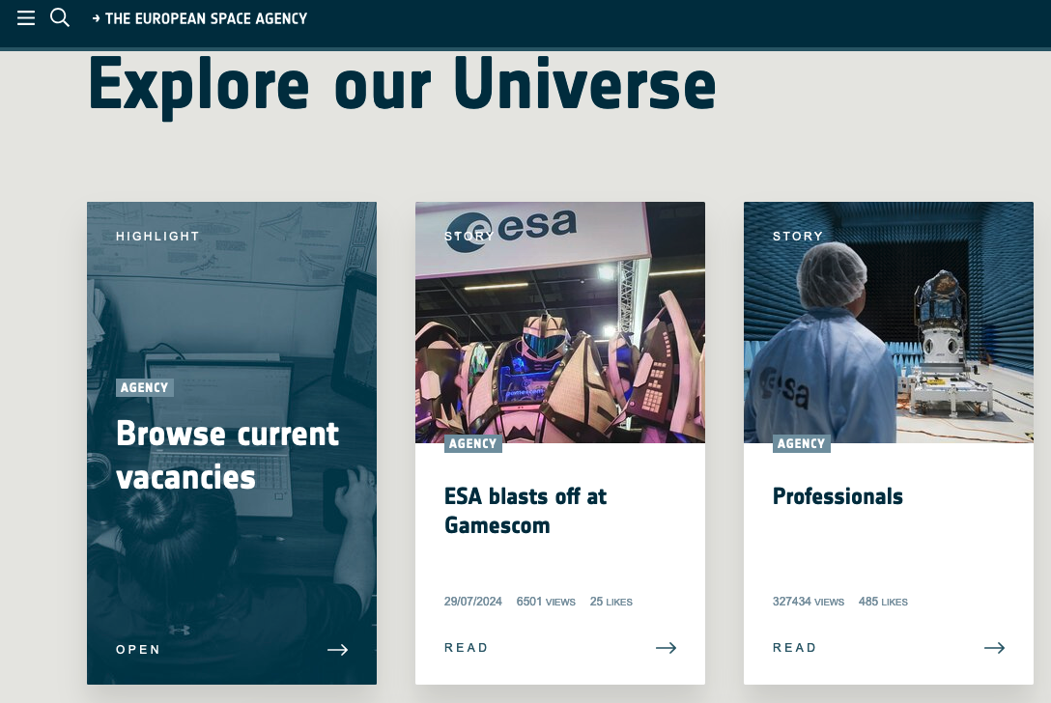


Slide 5
Main Research Topics
(Big) Data Analytics & Their Engineering*
  Data Analytics Design & Operation
  AI Software Engineering
  MLOps
AI-based Software Maintenance & Evolution
  Software-defined Everything (SDE)
  DevOps & Infrastructure-as-code
  Social & Organizational Aspects
* Often called Data Engineering

Slide 6




Slide 7

So, I know a thing or two about what I’m saying…

Slide 8

Before we start…
Questions are our friends!

Slide 9
Part 1: Course Overview!

Slide 10
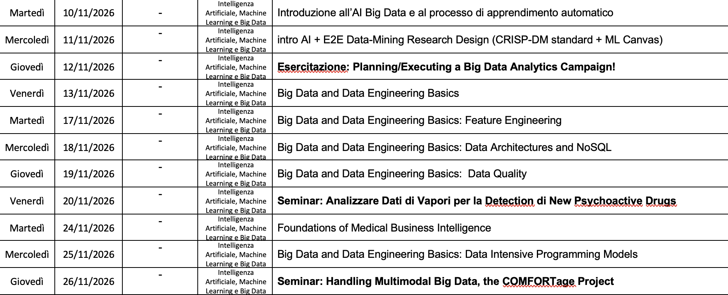

Slide 11

Materials*
https://github.com/maelstromdat/MediTechBigData
*Slides might vary in content! Keep checking them out!

Slide 12
Delivery Structure
Full-frontal Lecture (like today ☺)
Team-based project work
Seminar & Esercitazione:
  You will do the work live, but we’ll discuss it together!
  Project/Guest Presentation, our Q&A Afterwards

Slide 13
Delivery Structure
Full-frontal Lecture (like today ☺)
Team-based project work
x2 Practical Seminars
  Real Big Data Architectures to discuss together
  You will take a look, ask questions, imagine you have to work with them and guess what to do!

Slide 14
Project Work Specifications
Here’s what to do:
  Form a team and enroll as above;
  Find a dataset, find one which appeals to you, formulate a data architecture! More on this later ☺
  Investigate through it, study contents;
    I’ll give you the methods to explore it structurally and dynamically;
  Ask me questions if needed…
  Get started ASAP!

Slide 15
Project Work Specifications
Here’s what to do:
  Form a team and enroll as above;
  Find a dataset, find one which appeals to you, formulate a data architecture! More on this later ☺
  Investigate through it, study contents;
    I’ll give you the methods to explore it structurally and dynamically;
  Ask me questions if needed…
  Get started ASAP!

Slide 16
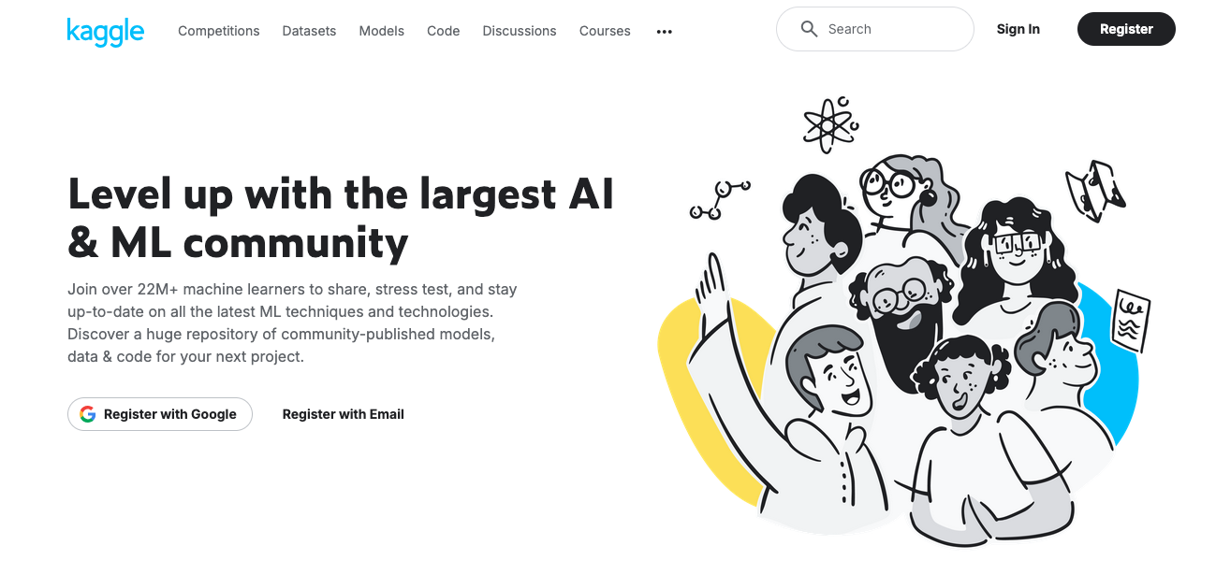
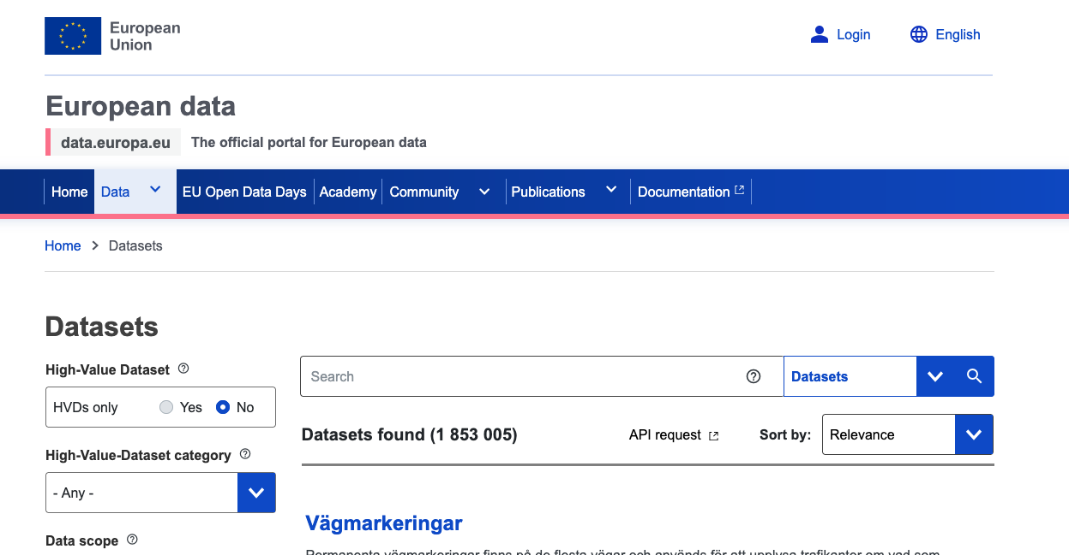
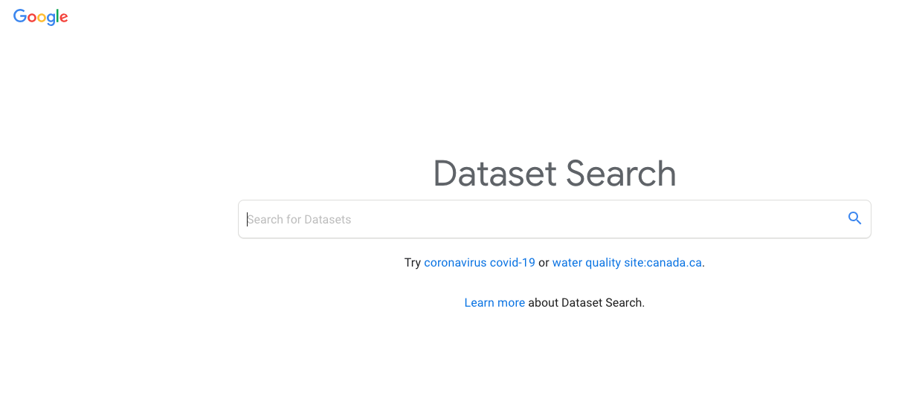

Slide 17
Project Work: Delivery
IEEE 2-column format (PDF)
  https://www.overleaf.com/latex/templates/ieee-conference-template/grfzhhncsfqn
Max 10 pages
Must include at least
  Intro to problem (with references)
    Specs over CRISP-DM campaign
  Background and related work (with references)
    Related works on the same topic/approach/domain
    Unused methodologies
  Research/solution Architectural design
    Design Decisions (Specification of ML Canvas)
    Data & Features
    Choice of modelling approach with rationale
  Usage Scenarios
    Roles and actors
  Discussion
  Conclusions

Slide 18
Project Work: Delivery (cont’d)
Presentation! [during the exam]
Must be a pitch (10 mins at most)
Focus on problems and how you solved them
Focus on eventual architecture solution and results
NOTE: the actual analytics are covered in Prof. Bernardi’s module!

Slide 19
Course Objectives
1. To design and document data architectures, data pipelines, and machine learning pipelines for data-intensive MediTech products or services
2. To apply the patterns and best practices in creating data architectures, data pipelines, and machine learning pipelines for MediTech
3. To assess/evaluate different data architectures, data pipelines, and machine learning pipelines in terms of the desired quality requirements

Slide 20
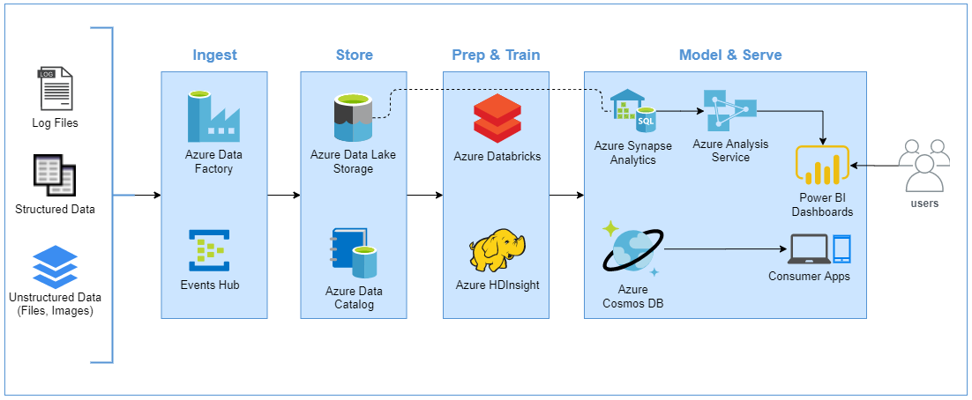
What are we talking about here generally?

Slide 21
What are we talking about here?
“An Artificial Intelligence is any algorithmical result that approximates a function following this pipeline.”
Cit., myself

Slide 22
What are we up to?
Big data, means lots of data that goes through the pipeline. Like, A LOT.

Slide 23
Disciplines Involved
Pure Data engineering
Data Analytics Setup
Data Operations

Slide 24
Disciplines Involved
Pure Data engineering
Data Analytics Setup
Data Operations
YOU ARE HERE!!!!

Slide 25
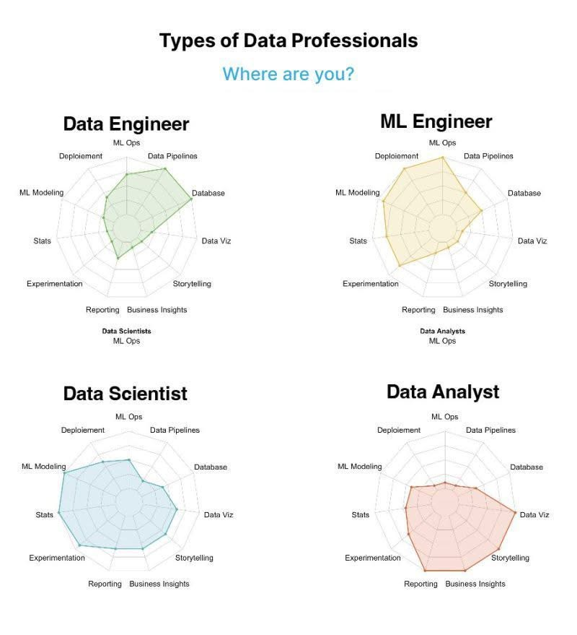

Slide 26
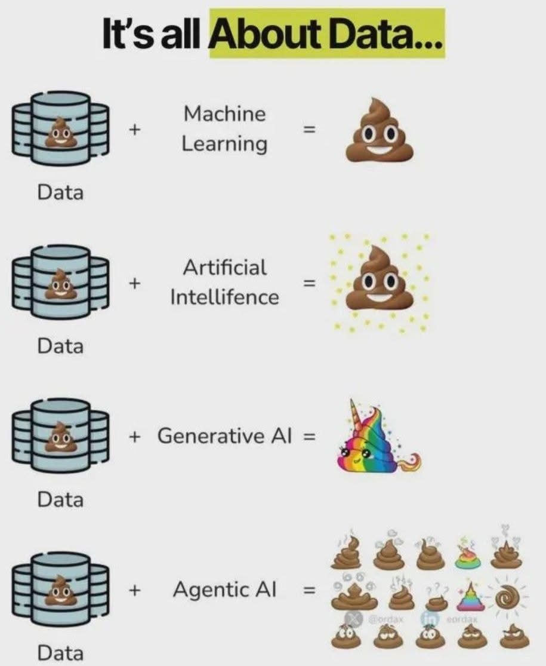
But…

Slide 27
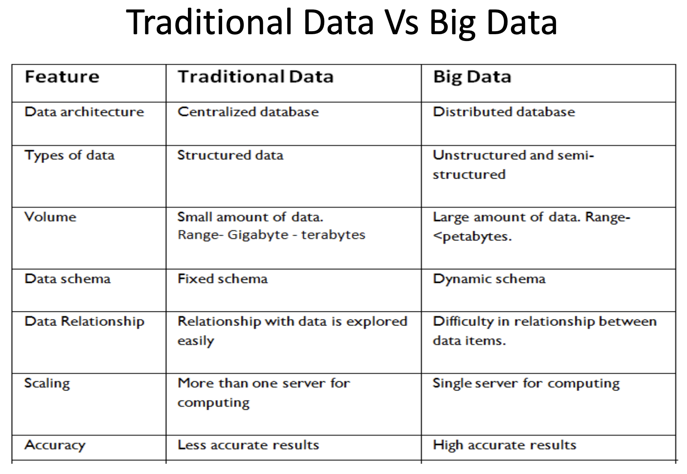

Slide 28
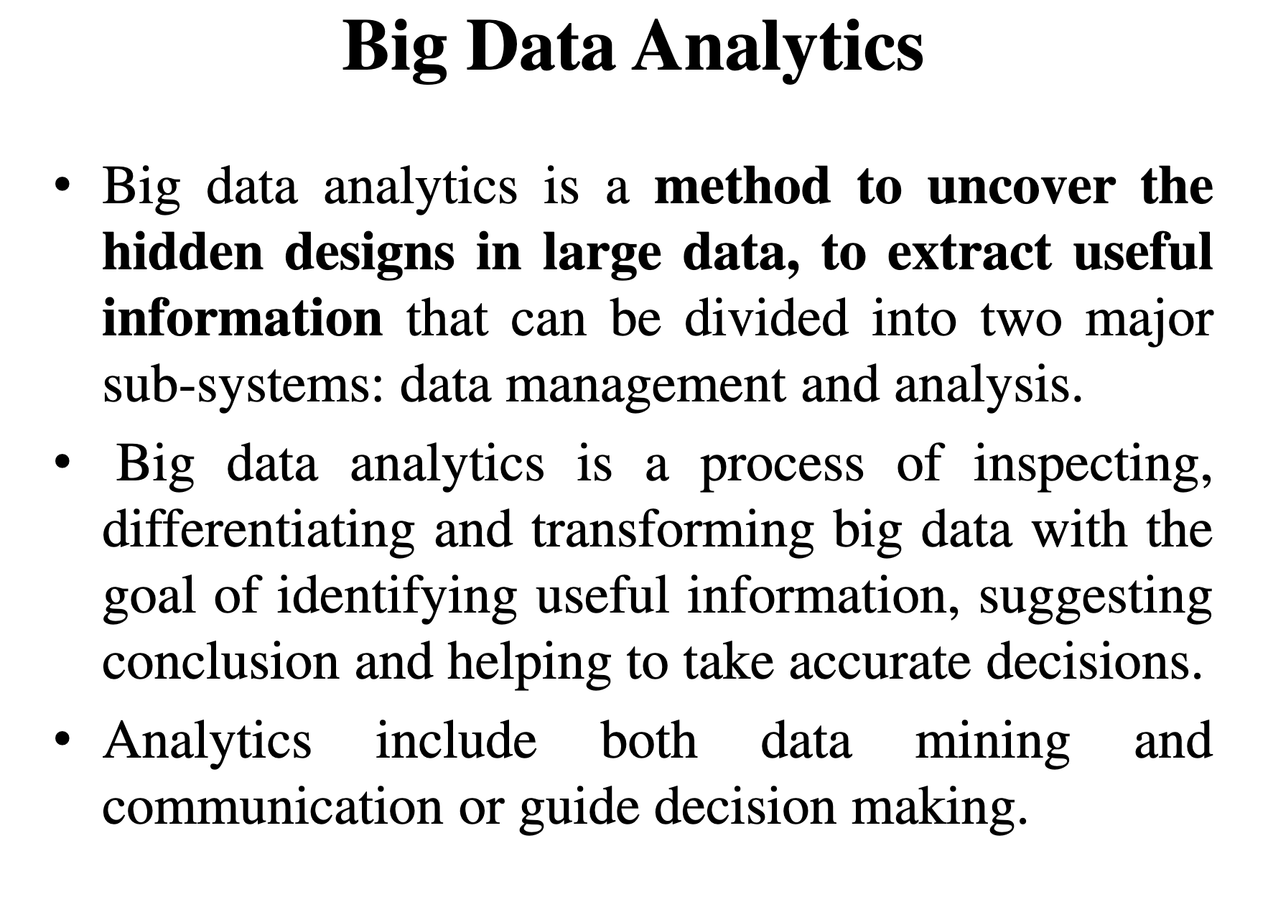

Slide 29
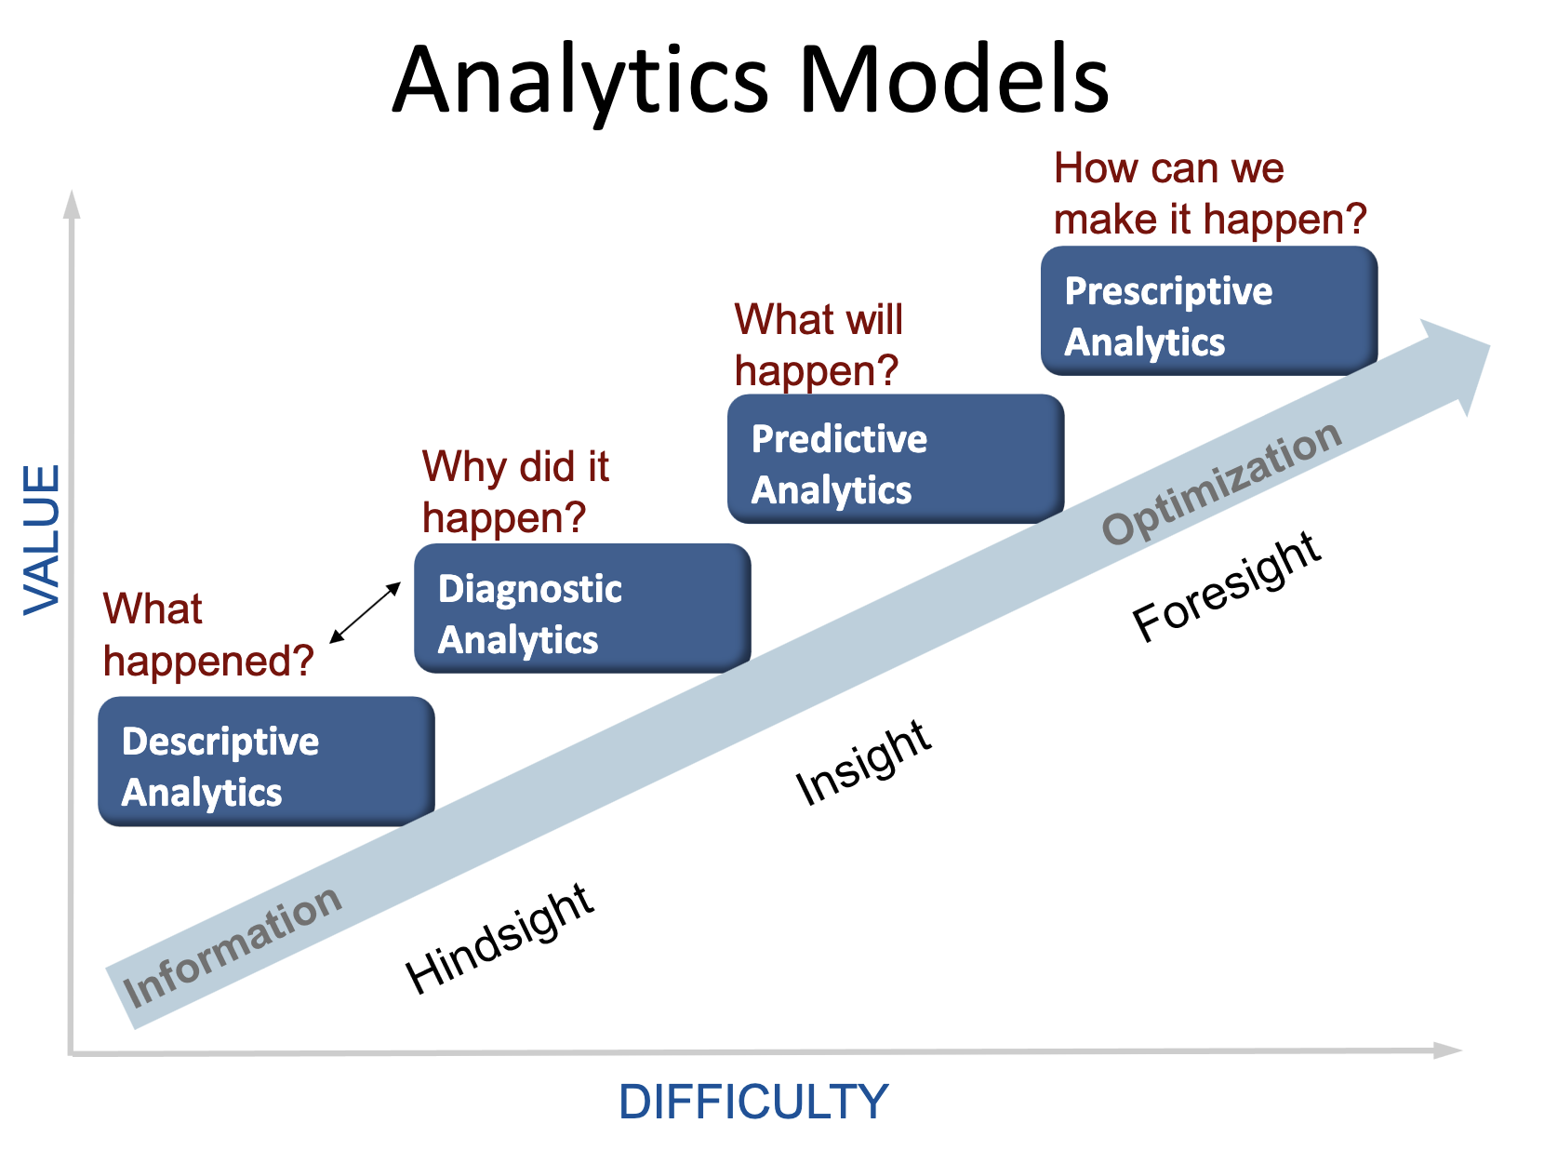

Slide 30
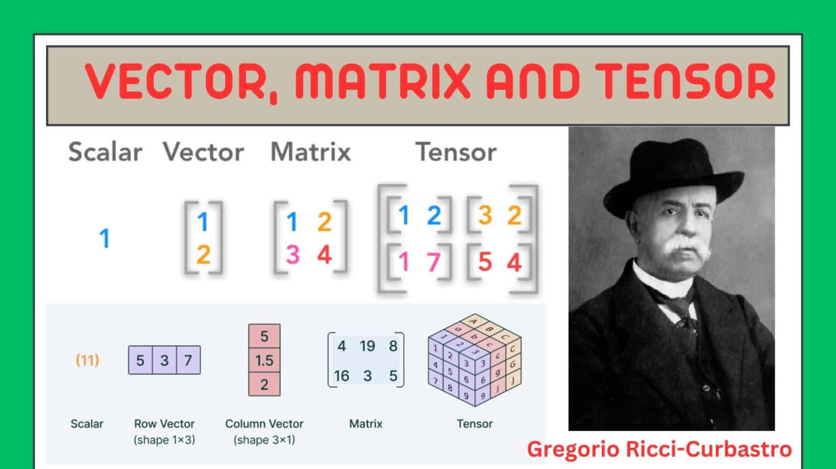
Starting point: different data representations…

Slide 31
Part 2: More Intro & Basic Notions

Slide 32
Building A Patient Sentiment Analyzer
A (small) dataset of product reviews (e.g., Bol, Amazon, etc.)
Data Preprocessing
Feature Engineering
Training a Sentiment Classifier
A single Notebook
(your laptop)
model
Test the Sentiment Classifier

Slide 33
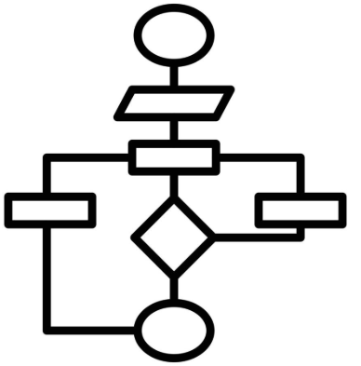


Building A Sentiment Analyzer: Production Industrial Environment
scraping
Product websites
Data sets
Data Pipeline
Source Code Repository
who needs the integration of the sentiment analysis capabilities with its application
Continuous Training Pipeline
Model Repository
reviews
Sentiment Analyzer User Interface
Sentiment Analyzer API
CI/CD Pipelines to build, test, and deploy automatically
sentiments
/analyze_review
Customers
(from 3rd-party
companies)
In the cloud or a private data center

Slide 34
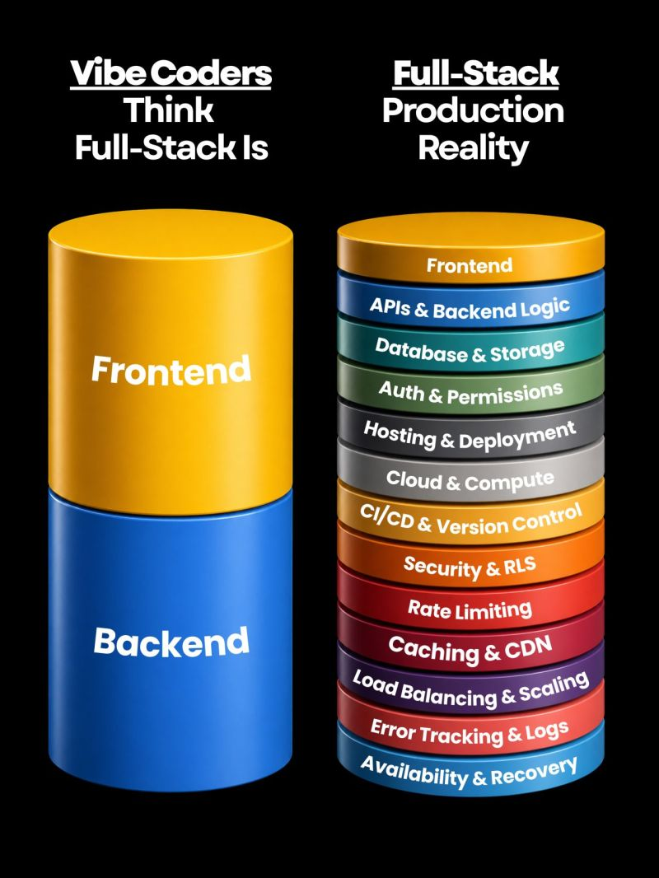
Vibe Code vs Production Reality
Vibe coding is incredible for proving an idea. It turns weeks of work into hours.
But shipping a real product still needs real engineering.
In this course and Dr. Bernardi’s module, we want to focus on "real data architectures + AI analytics for MediTech".
Reference: https://lnkd.in/p/err8Md2m
Notes:
→ Auth and permissions → Hosting and deployment → Cloud and compute → CI/CD and version control → Security and Row Level Security → Rate limiting → Caching and CDN → Load balancing and scaling → Error tracking and logs → Database hardening → Availability and recovery

Slide 35
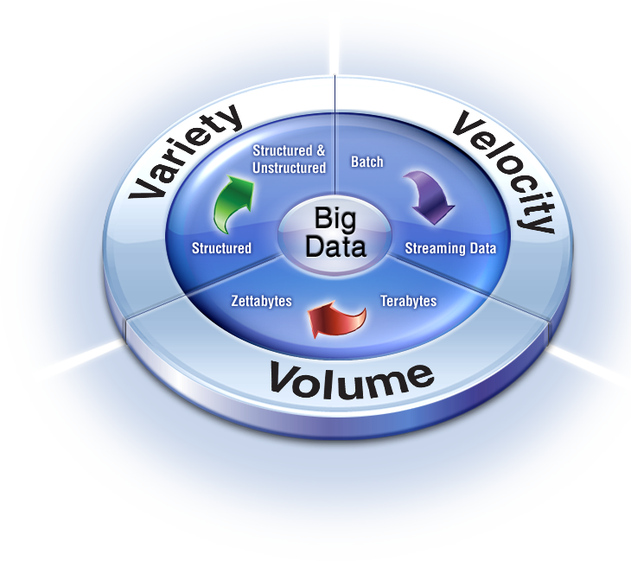
What is Big Data Technically?
Big data refers to extremely large and diverse collections of structured, unstructured, and semi-structured data that continue to grow exponentially over time. [Google]
“3 Vs of big data” (Gartner, 2001)

Slide 36
V^{3:} Volume, Velocity and Variety
Volume:
  Enterprises are awash with ever-growing data of all types, easily amassing terabytes—even petabytes—of information.
Velocity:
  This refers to the speed at which data is generated, collected, and processed, also yields two flavors: (a) batch; (b) stream.
  Sometimes 2 minutes is too late. For time-sensitive processes (real-time or near real-time), such as detecting fraud, big data must be leveraged as it streams into the enterprise to maximize its value.
Variety:
  Big data is any type of data – structured, semi-structured, and unstructured data such as text, sensor data, audio, video, click streams, log ﬁles, and more.
Notes:
"Near real time" (NRT) refers to a data processing system with a slight, acceptable delay between the occurrence of an event and the use of the processed data, typically ranging from seconds to a few minutes, as opposed to the milliseconds of delay in true real-time systems.

Slide 37
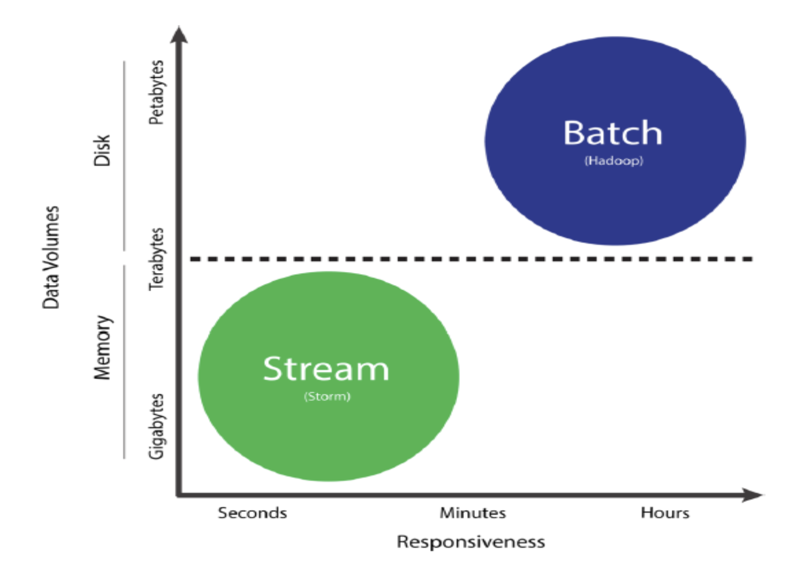

Slide 38

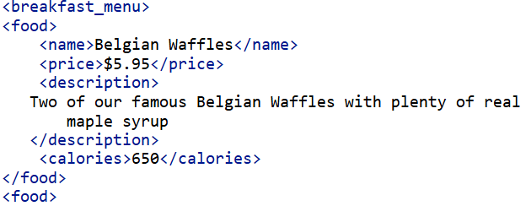
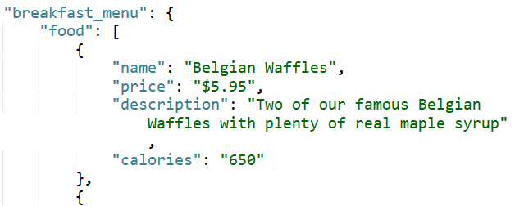
(Big) Data Structure
Structured data:
  Data has a predefined data model and is organized and categorized in a well-defined format (a rigid, fixed schema).
  E.g., Data in Relational Databases (ER model)
Semi-structured data: XML, JSON, CSV, HTML, etc.
Unstructured data: natural language, video, images, etc.

Slide 39
Quiz: Select Vs and their Subcategories
US1: Twitter/X
  Alert me whenever a tweet related to Climate Change is mentioned more than 3 times in under 10 seconds
  What are the top K tweets in each month of 2023?
UC2: Supply Chain Monitoring
  Using satellite imagery and geospatial data to measure and predict the social and environmental impacts of supply chain operations
  Visualize the fleets of a delivery company in real-time, including shipment status and route progress
UC3: Stock Trading
  What is IBM’s maximum stock value in the last five seconds?
  How much profit was obtained by trading IBM stocks by Company Y in January 2024?
Stream and semi-structured
Batch and semi-structured
Batch and unstructured
Stream and unstructured/semi-structured
Stream and semi-structured
Batch and structured/semi-structured

Slide 40
Beyond Conventional Data Engineering …

Slide 41
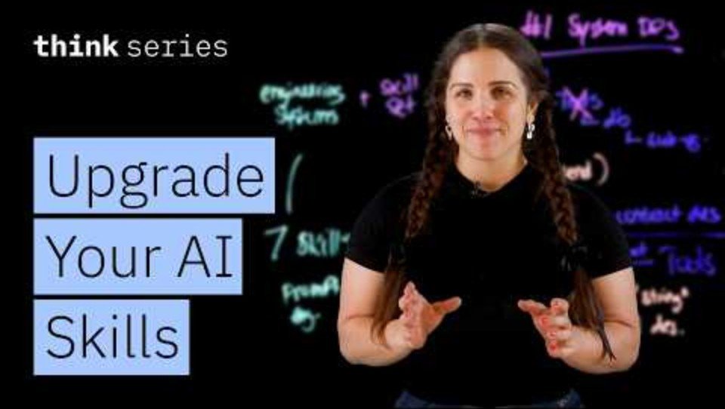
The 7 Skills You Need to Build AI Agents (IBM)
System Design
Tool & contract design
Retrieval engineering
Reliability engineering
Security and safety
Evaluation and observability
Product thinking

Slide 42
The 7 Skills You Need to Build AI Agents (IBM)
System Design
Tool & contract design
Retrieval engineering
Reliability engineering
Security and safety
Evaluation and observability
Product thinking

Slide 43

What is the point of all this?
MediTech Intelligence

Slide 44
Foundation of Big Data Analytics: Gathering Intelligence http://en.wikipedia.org/wiki/Business_intelligence
computer-based techniques used in spotting, digging-out, and analyzing business data
BI technologies provide historical, current, and predictive views of business operations
Common functions of business intelligence technologies are reporting, online analytical processing, analytics, data mining
For example Business intelligence aims to support better business decision-making with data mining and data workflows (including data modelling, AI, etc.)

Slide 45
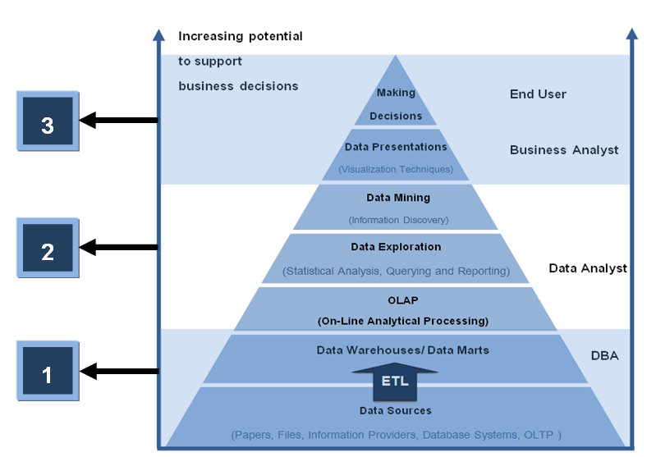
Data Mining + Data Workflows => BI
BI

Slide 46
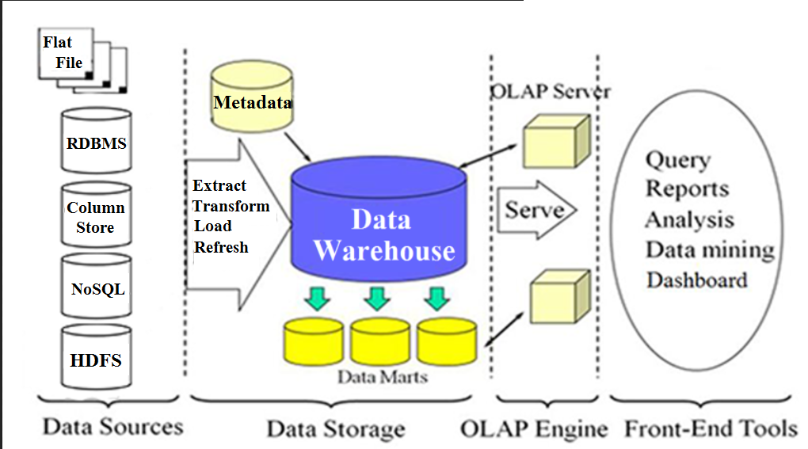
Typical Intelligence System Architecture
On-Line Analytical Processing

Slide 47
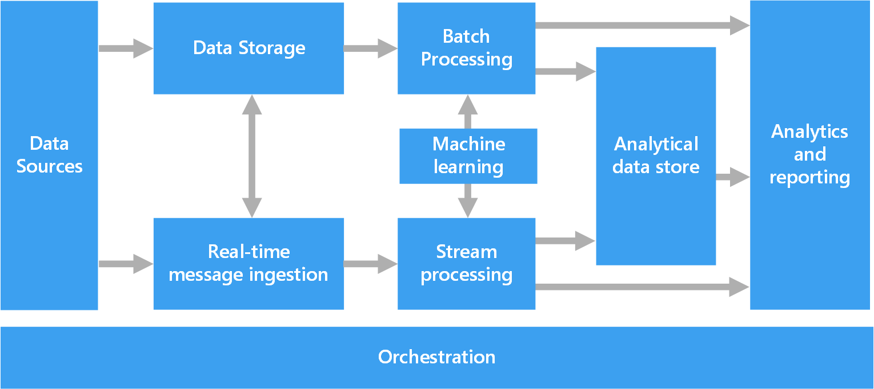
Typical Components of a Big Data Architecture
Monitoring and Governance
https://learn.microsoft.com/en-us/azure/architecture/data-guide/big-data/
Notes:
Most big data architectures include some or all of the following components:
Data sources. All big data solutions start with one or more data sources. Examples include:
Application data stores, such as relational databases.
Static files produced by applications, such as web server log files.
Real-time data sources, such as IoT devices.
Data storage. Data for batch processing operations is typically stored in a distributed file store that can hold high volumes of large files in various formats. This kind of store is often called a data lake. Options for implementing this storage include Azure Data Lake Store or blob containers in Azure Storage.
Batch processing. Because the data sets are so large, often a big data solution must process data files using long-running batch jobs to filter, aggregate, and otherwise prepare the data for analysis. Usually these jobs involve reading source files, processing them, and writing the output to new files. Options include running U-SQL jobs in Azure Data Lake Analytics, using Hive, Pig, or custom Map/Reduce jobs in an HDInsight Hadoop cluster, or using Java, Scala, or Python programs in an HDInsight Spark cluster.
Real-time message ingestion. If the solution includes real-time sources, the architecture must include a way to capture and store real-time messages for stream processing. This might be a simple data store, where incoming messages are dropped into a folder for processing. However, many solutions need a message ingestion store to act as a buffer for messages, and to support scale-out processing, reliable delivery, and other message queuing semantics. This portion of a streaming architecture is often referred to as stream buffering. Options include Azure Event Hubs, Azure IoT Hub, and Kafka.
Stream processing. After capturing real-time messages, the solution must process them by filtering, aggregating, and otherwise preparing the data for analysis. The processed stream data is then written to an output sink. Azure Stream Analytics provides a managed stream processing service based on perpetually running SQL queries that operate on unbounded streams. You can also use open source Apache streaming technologies like Spark Streaming in an HDInsight cluster.
Machine learning. Reading the prepared data for analysis (from batch or stream processing), machine learning algorithms can be used to build models that can predict outcomes or classify data. These models can be trained on large datasets, and the resulting models can be used to analyze new data and make predictions. This can be done using Azure Machine Learning
Analytical data store. Many big data solutions prepare data for analysis and then serve the processed data in a structured format that can be queried using analytical tools. The analytical data store used to serve these queries can be a Kimball-style relational data warehouse, as seen in most traditional business intelligence (BI) solutions. Alternatively, the data could be presented through a low-latency NoSQL technology such as HBase, or an interactive Hive database that provides a metadata abstraction over data files in the distributed data store. Azure Synapse Analytics provides a managed service for large-scale, cloud-based data warehousing. HDInsight supports Interactive Hive, HBase, and Spark SQL, which can also be used to serve data for analysis.
Analysis and reporting. The goal of most big data solutions is to provide insights into the data through analysis and reporting. To empower users to analyze the data, the architecture may include a data modeling layer, such as a multidimensional OLAP cube or tabular data model in Azure Analysis Services. It might also support self-service BI, using the modeling and visualization technologies in Microsoft Power BI or Microsoft Excel. Analysis and reporting can also take the form of interactive data exploration by data scientists or data analysts. For these scenarios, many Azure services support analytical notebooks, such as Jupyter, enabling these users to leverage their existing skills with Python or R. For large-scale data exploration, you can use Microsoft R Server, either standalone or with Spark.
Orchestration. Most big data solutions consist of repeated data processing operations, encapsulated in workflows, that transform source data, move data between multiple sources and sinks, load the processed data into an analytical data store, or push the results straight to a report or dashboard. To automate these workflows, you can use an orchestration technology such Azure Data Factory or Apache Oozie and Sqoop.

Slide 48
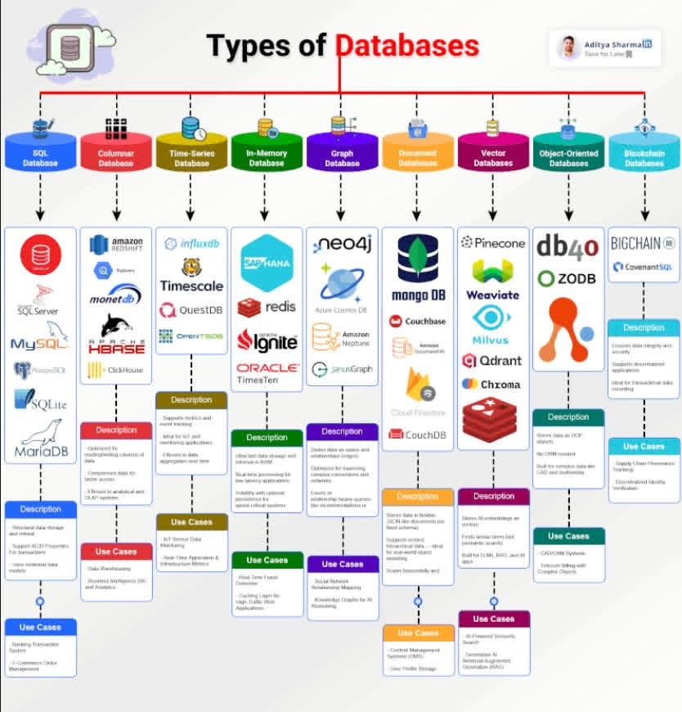

Slide 49
Data Analytics vs. Statistics
Data Mining | Statistics or Something Else? at http://www.daa.com.au/analyticalideas/datamining.html
(change to https://www.daa.com.au/articles/analytical-ideas/ )
DATA MINING AND STATISTICS: WHAT IS THE CONNECTION? At
http://www.tdan.com/i030fe01.htm
(change to http://tdan.com/data-mining-and-statistics-what-is-the-connection/5226)
Data mining Techniques at
http://www.statsoft.com/textbook/stdatmin.html#eda1
(change to http://www.statsoft.com/Textbook/Data-Mining-Techniques#eda1)
CRoss Industry Standard Process
for Data Mining (CRISP-DM) at http://www.crisp-dm.org/
(no longer available since around 2012?)
https://www.kdnuggets.com/2014/10/crisp-dm-top-methodology-analytics-data-mining-data-science-projects.html
  look at Process Model of CRISP-DM 1.0

Slide 50
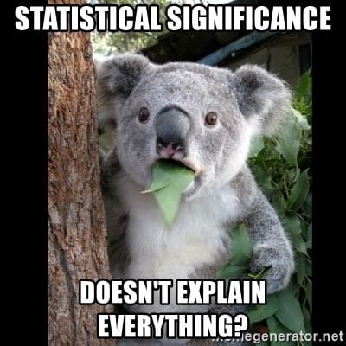
In Statistics: Testing! Testing! Testing!
In Big Data: Statistical Description + Testing ➔ Feature Engineering!

Slide 51
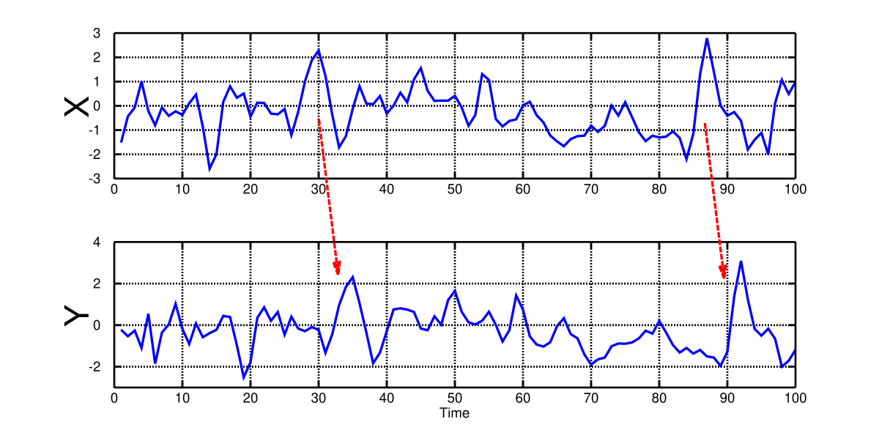
E.g.: Causality Testing*
*image courtesy of Granger Causality Testing on Wikipedia

Slide 52
In big Data Analytics: Features! Features! Features!
If you take millions, billions of features, you get a big structured dataset;
If you get only huge quantities of raw data you get a big un-structured dataset;

Slide 53

Questions?

